Slide 1
How Does a Bike-Share Navigate Speedy Success?
Presented By Audra Roberts
Last Updated: May 28, 2022

Slide 2
Table of Contents
Business Task
Data
Recommendations
Appendix

Slide 3
What are we talking about?

Slide 4
Overview of Cyclistic
Based in Chicago
Bike-share program that features more than 5800 bicycles and 600 docking stations
Offers reclining bikes, hand tricycles, and cargo bikes
Currently, Cyclistics marketing strategy relies on building general awareness and appealing to broad consumer segments

Slide 5
Business Task
Cyclistic’s goal is to design marketing strategies aimed at converting casual riders into annual members.
To address this, this question needed to be answered: How do annual members and casual riders use Cyclistic bikes differently?
This question will be the first step in building a marketing strategy to address the casual user demographic.

Slide 6
Stakeholders
Lily Moreno
Director of Marketing and manager
Responsible for the development of campaigns and initiatives to promote the bike-share program
Cyclistic marketing analytics team
Team of data analysts who are responsible for collecting, analyzing, and reporting data that helps guide Cyclistic’s marketing strategy
Cyclistic executive team
Notoriously detail-oriented
Will decide whether to approve the recommended program

Slide 7
Data

Slide 8
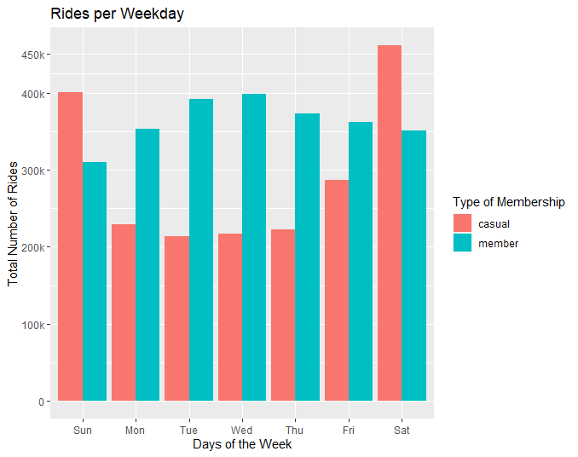
Members predominantly use the bikes on weekdays.
Casuals predominantly use the bikes on weekends.

Slide 9
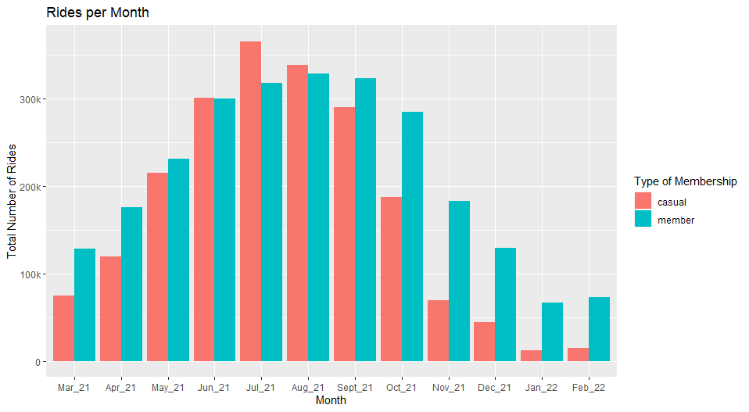
Bike usage is high in the summer months and low in the winter months for both members and casual users.
Omicron/Delta Variant Surge
Notes:
Correlated events that may be a factor to this phenomena:
Weather conditions
Local events that are tied to that season
https://chicago.suntimes.com/entertainment-and-culture/2021/5/7/22417349/summer-chicago-festivals-events-rescheduled-2021-music-neighborhoods
November 2021 - February 2022 was the surge of the Omnicron Variant, which may have impacted travel.
https://news.wttw.com/2021/12/07/chicago-facing-very-significant-covid-19-surge-omicron-variant-looms-top-doc-says

Slide 10
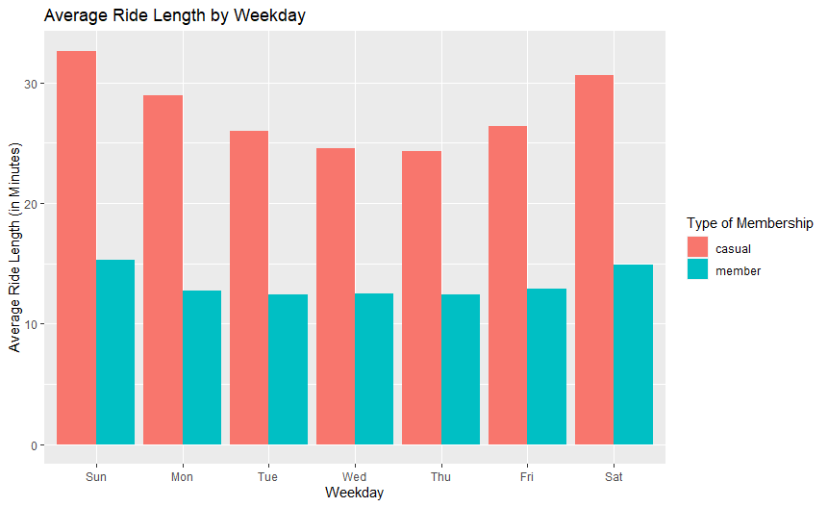
Members, on average, have shorter trip durations on weekdays, which may be attributed to going to and coming back from work.
Average duration: 13 minutes
Casual users, on average, have longer trip durations on weekdays.
Average duration: 28 minutes

Slide 11
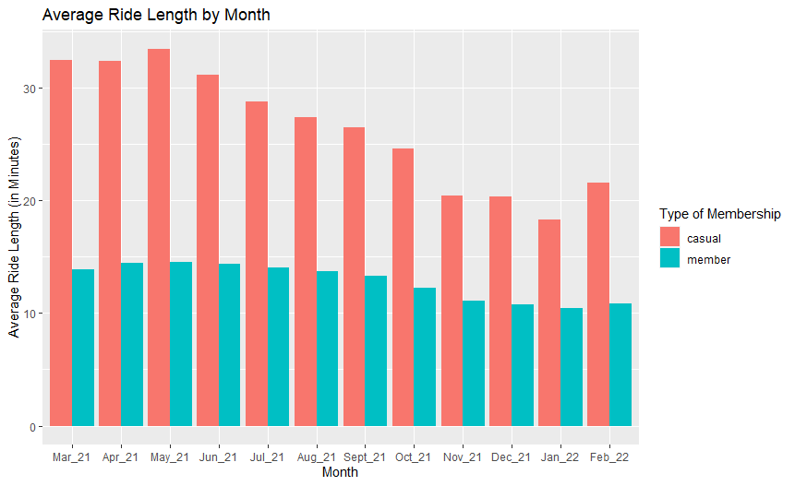
The average ride length appears to be consistent for both casual users and members throughout the year.
Longer trip duration for casual users.
Shorter trip duration for members.
Members, on average, have consistent trip durations throughout the year, possibly attributed to the typical work week.

Slide 12
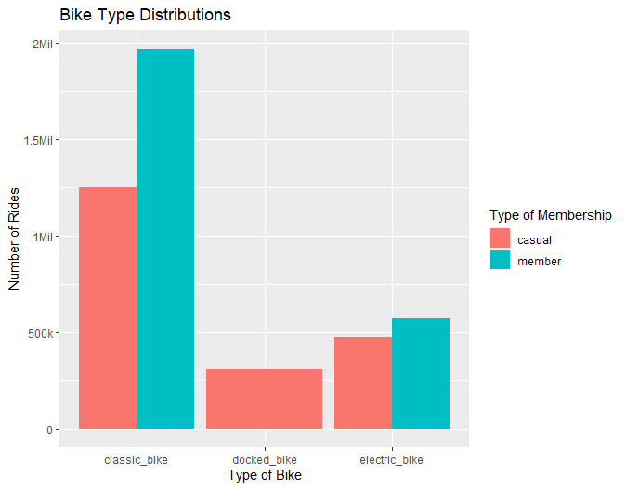
Classic bikes appear to be the go-to-bike for both casual users and members.
Casual users seem to also exclusively favor docked bikes.

Slide 13
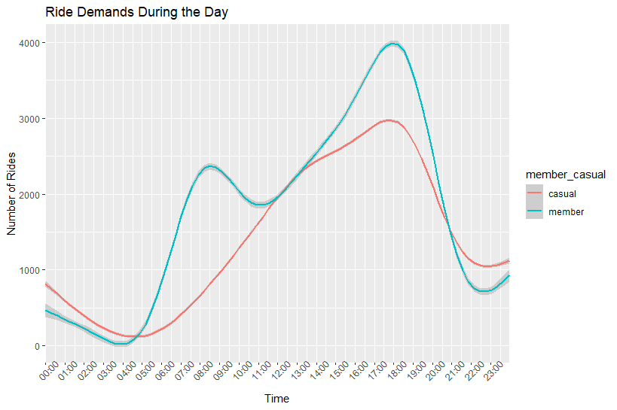
For members, ride demands increase between 4 AM to 9 AM, and again from 12 PM to 5:30 PM.
These times correspond to the typical 9-to-5 working hours
For casuals ride demands have a larger interval, starting at 4PM, reaching its peak at 5:30 PM.

Slide 14
Recommendations

Slide 15
Recommendations
Design weekend or trip duration marketing campaigns on the rideshare app that will incentivize casual users to convert to members.
Create partnerships with go-to destinations casual users frequent that incentivize membership enrollment.
Tracking data since the offset of COVID-19 until now, and comparing the data to pre-pandemic findings may provide more insight on how our current marketing strategy faired from 2020 to 2022 and what adjustments would need to be made for marketing in light of changing, governmental regulations on COVID-19.

Slide 16
Appendix

Slide 17
Appendix
About and Notes

